Slide 1
Our Research Focus
S.Thamarai Selvi
Professor of Computer Science & Engineering
Madras Institute of Technology
Anna University
Chennai 600 044
India.
&
Chief Investigator
Centre for Advanced Computing Research and Education
E Mail: stselvi@annauniv.edu
URL: www.annauniv.edu/care

Slide 2
Acknowledgement
Centre for Advanced Computing Research and Education (CARE) that is sponsored by DIT, Government of India

Slide 3

Agenda
Our Research Experience
Current Research
Conclusion

Slide 4
Our Research Contributions
Technology Partner to GARUDA Grid
Contribution to Globus, Gridway etc…
Consultancy to Honeywell Technology Solutions
Collaboration with MIMOS
Joint activity with Athabasca University
Training Faculty and Students
Developing Utilities for beginners
Collaborative research activities

Slide 5
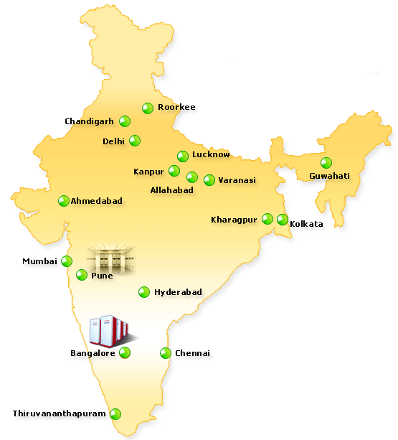
Garuda India
Technology partner to
GARAUDA - India Grid
Aggregation of heterogeneous
and geographically distributed
resources such as computing,
Storage and special equipment
from various research labs and
Academic institutions across the
Country
CDAC – PARAM PADMA
Notes:
5

Slide 6
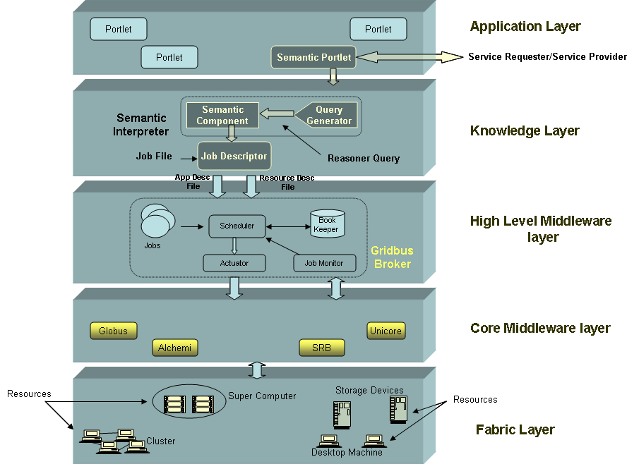
Semantic Description and Discovery of Grid Resources
Semantic Component enables semantic
description and discovery of grid resources.
Protégé-OWL APIs are used to create
knowledge base of grid resources using
a resource ontology template.
MDS is used to aggregate resource
information
We use Algernon Inference Engine to
discover suitable resource
This module has been successfully integrated
With Garuda, a National Grid Computing
Initiative
Notes:
This research work is a part of the project titled Development of Front End Tools for Semantic Grid Services sponsored by CDAC, Bangalore.
The complete project description can be obtained from http://www.gridbus.org/tech_reports.html

Slide 7
Semantic Component for Gridbus Broker – Rajkumar Buyya
User
Submits job
GridBus
Broker
Results
Semantic
Description
Algernon
Query
Knowledge
Base
Resource
Description
Resource
Discovery
Query
Generator
Querying
OWL file
Resource Information
MDS
Resources

Slide 8
Features
Describe Grid resources using Ontological representation
Uses Inference engine for information retrieval from ontology knowledge base
Integrated with Gridbus Broker
With necessary modification, integrated with Garuda Grid portal as Advanced Search facility

Slide 9
Trust Component
A two year project funded by DIT, India
Research Activities @ CARE
Notes:
9

Slide 10
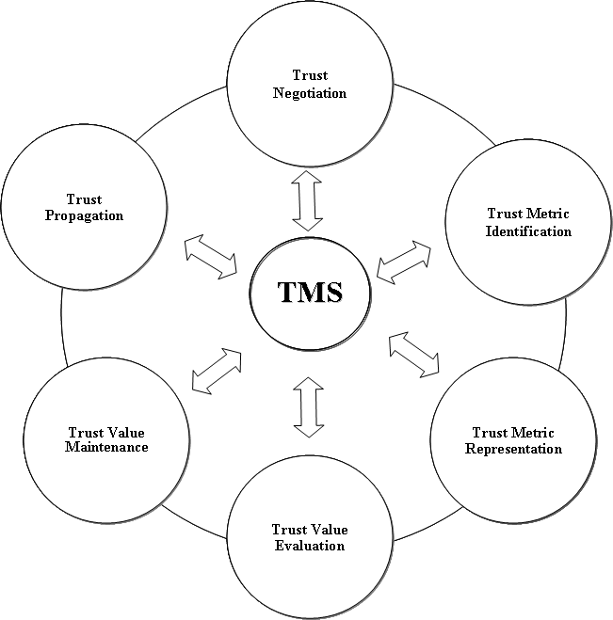
Trust Lifecycle
Research Activities @ CARE
Notes:
10

Slide 11
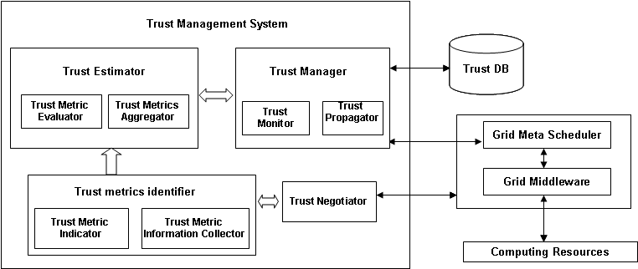
Trust Management System
Research Activities @ CARE
Notes:
11

Slide 12
Features
Computes trustworthiness of every grid resource
Considers “objective” parameters such as availability, success rate, and bandwidth
Integrated with Gridway and to select grid resources based on trust value
Research Activities @ CARE
Notes:
12

Slide 13
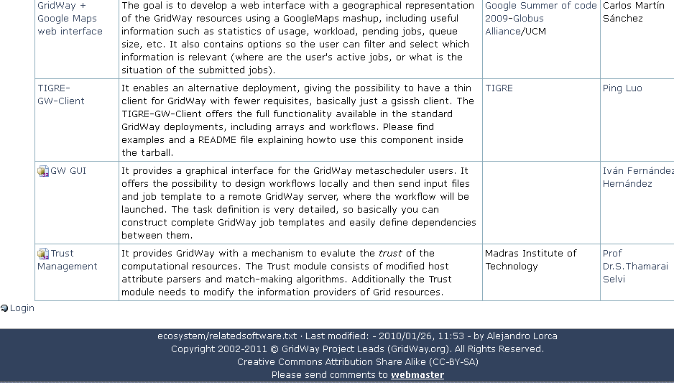
Integrated with Gridway Meta Scheduler
http://www.gridway.org/doku.php?id=ecosystem:relatedsoftware

Slide 14
PATENT
Filed Application for patent (Patent application No.593/CHE/2007 A)
Title of Invention:
A System and a method to assess the trustworthiness of a resource provider
International Classification:G06F 17/30
Patent Received in 2010

Slide 15
Virtual Cluster Development Environment
Deploy a virtual cluster on the fly
Globus Toolkit has been used as middleware
Incubator project from Globus
GT AUTOINSTALL Utility

Slide 16
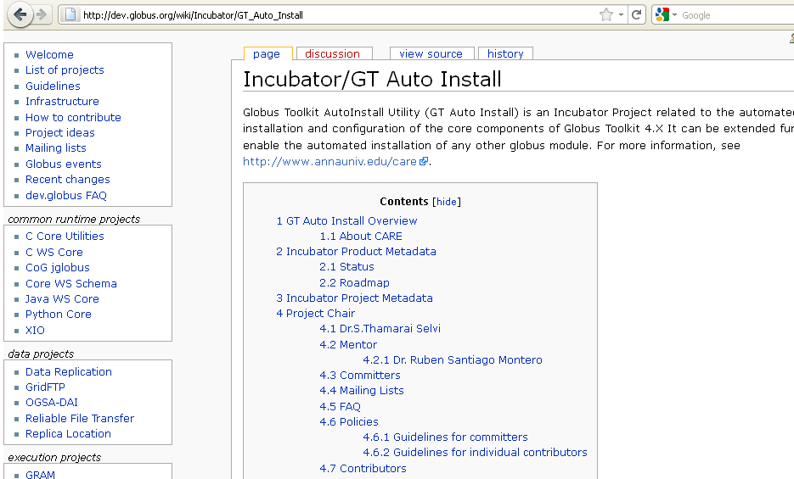

Slide 17
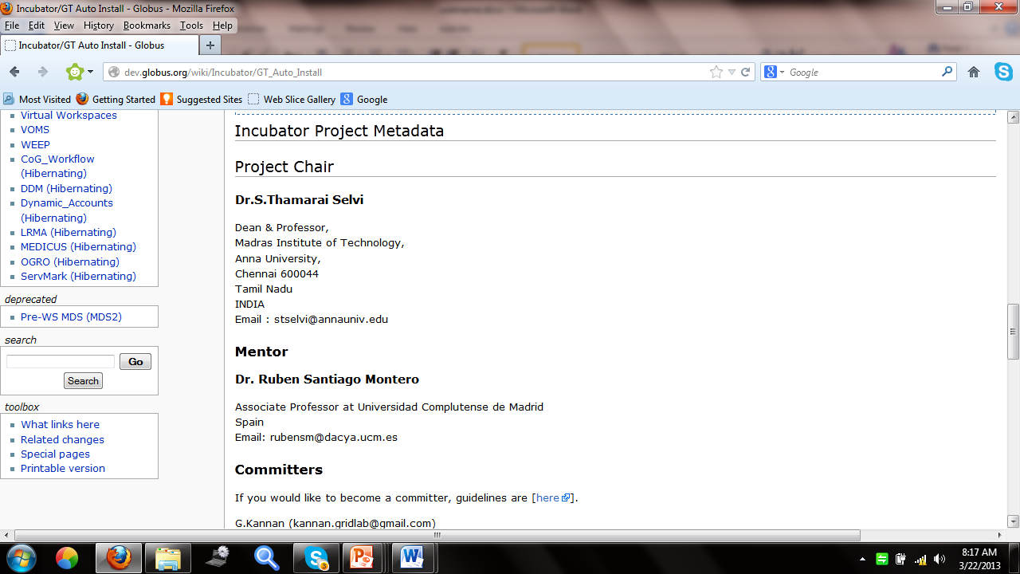

Slide 18
Honeywell Technology
Using virtualization technology, utilize the underutilized resources for testing CFD applications

Slide 19
Architecture
Discovers suitable NDNs across LAN and boots appropriate VM in it.
Aggregates NDN resource information in an XML format
VM-Ansys Image
NDN Scheduler
VM- CFX Image
NDN Identifier
VM- Fine/Turbo Image
VM interface is to start / poweroff VMs
VMware server
NDN list
VM,NDN-ID
SGE monitor checks the status of submitted job to SGE and picks out pending jobs* and Schedules them through NDN scheduler
SGE Monitor
VM Interface
NDN
Information
Manager
Manages the list of NDN across LAN
SGE
VMs are connected to
SGE When booted
User
…
HostOS
HostOS
….
HostOS
SGE Execution Nodes
Non Dedicated Nodes (NDN)
* Jobs that are in pending state due to non availability of slots

Slide 20
MIMOS - Malaysia
Description
The gLite infrastructure of MIMOS possess high end servers which could be utilized for the execution of jobs realizing virtualization technique.

Slide 21
Virtual Machine Deployment – Phase I
Objective
To identify the physical server in which required number of worker nodes can be created as virtual machines
To dynamically deploy and manage worker node in the form of virtual machines on EGEE gLite infrastructure.
21

Slide 22

Job flow in gLite infrastruture
WNs
UI can query the status of job and if job is finished, it can download the results
After the completion of job, CE sends the result back to WMS
UI
WMS
CE
User can submit a job to WMS by means of CLI
WMS finds the suitable CE for the job execution and submits job
Submits job to Worker node for its execution
BDII updates the information about various CEs to WMS at regular intervals
BDII
UI - User Interface
WMS - Workload Management System
BDII - Berkley Database Information Index
CE - Computing Element
WN - Worker Node
22

Slide 23
Job flow - Virtual machine deployment
Submits the job to the suitable CE
Job Queue (Q1)
WNs
Job4
Job3
User Interface
Job3
WMS
Job2
CE
Job1
Job2
Job1
User submits job to WMS
Job4
Virtual Worker nodes
WMS selects the best suitable CE using the information obtained from BDII
XEN
XEN
XEN
OS
OS
OS
Physical servers
23

Slide 24
Proposed Architecture for Phase II
User Interface
Workload Management System
Computing Element
LRMS
VM Manager
Resource Matchmaker
LRMS Batch Queue Monitor
IP/HN Constructor
Resource Identifier
Matchmaking
policy
Job Scheduler
Scheduling
policy
WN Creator
WN Destroyer
Server List
WN Tracker
Compute Element
Centralized Information Controller
Virtual Machine information Collector
VM Log
Physical Resource Information Collector
Resource
Repository

Slide 25
Our CARE Resource Broker
Semantic description of resources
SLA Negotiation
Heuristic Scheduling
Trust management Integration
Virtual resource provisioning

Slide 26
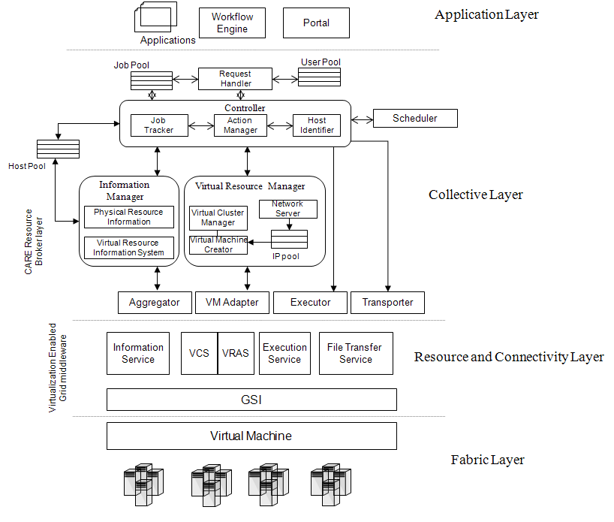
Layered Architecture

Slide 27
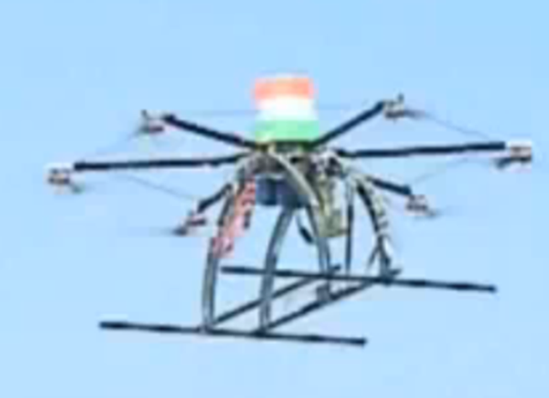
Cloud for DHAKSHA
Our department of Aeronautical engineering has Avionics Division
Faculty and students developed Unmanned Aerial Vehicle (UAV) System
Successfully completed
UAV Forge entry test
conducted by NASA

Slide 28
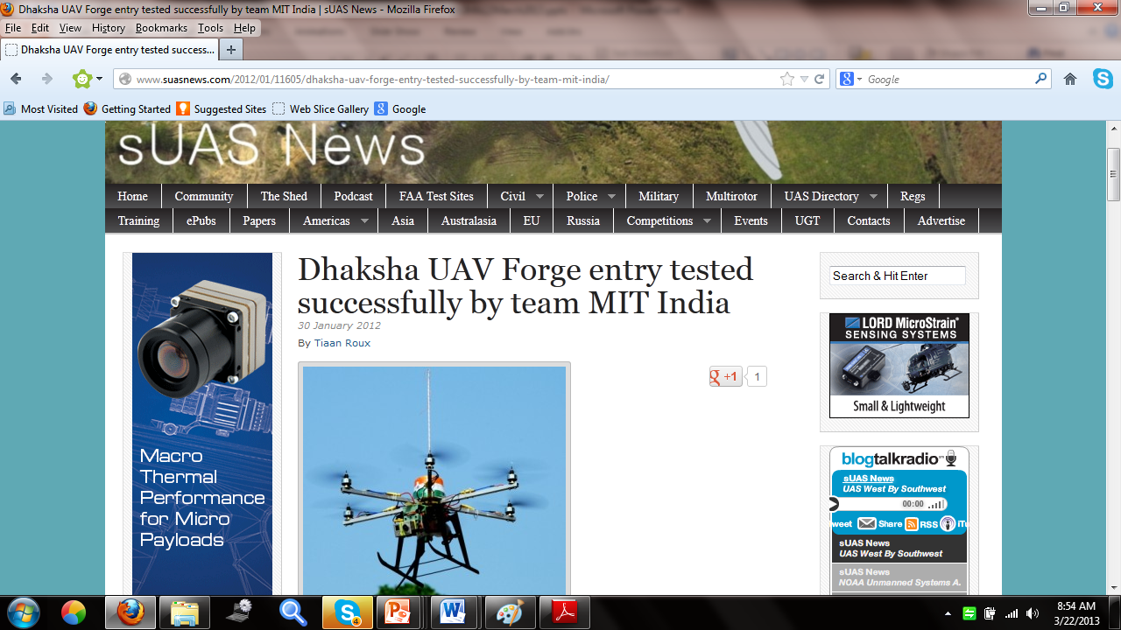
UAV Forge Entry

Slide 29
Dhaksha team at USA

Slide 30
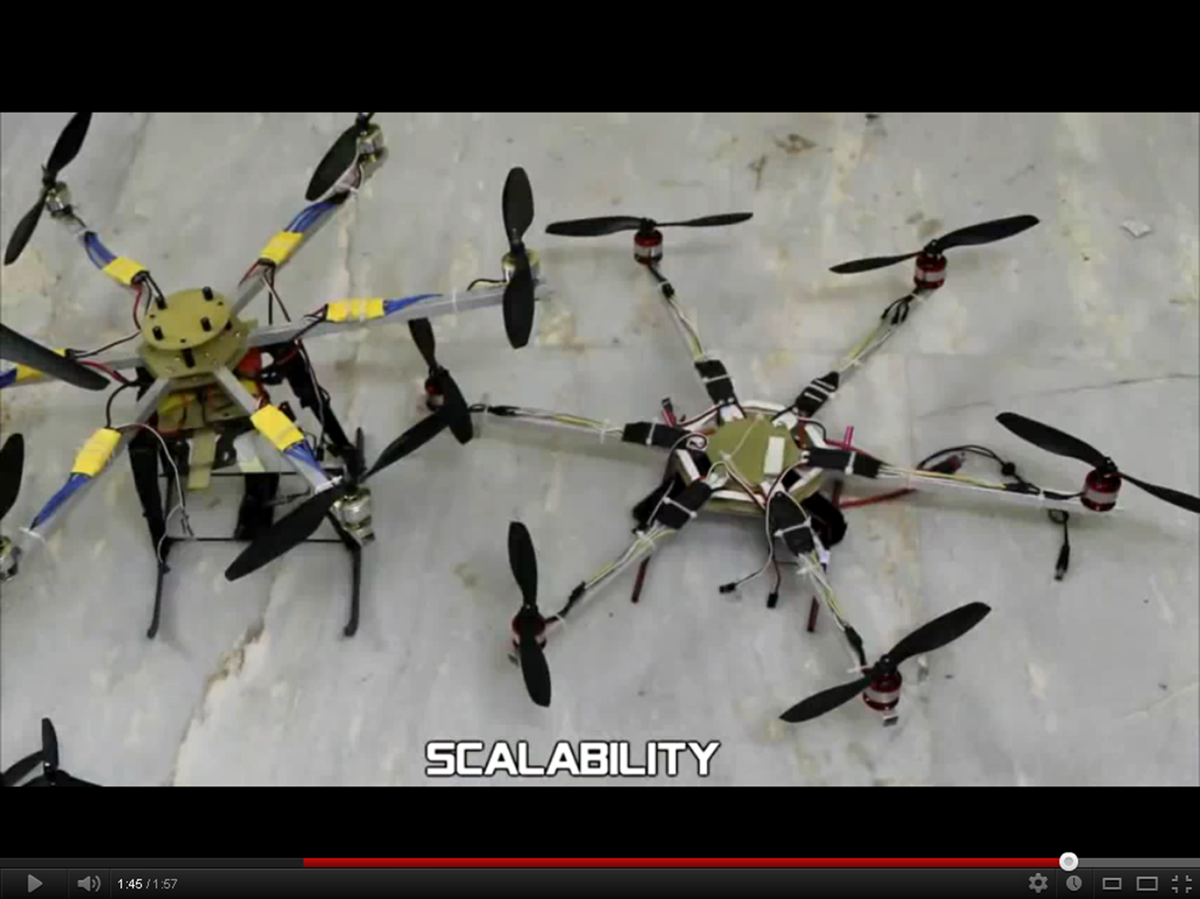
DHAKSHA :UAV of Madras Institute of Technology, Anna University

Slide 31
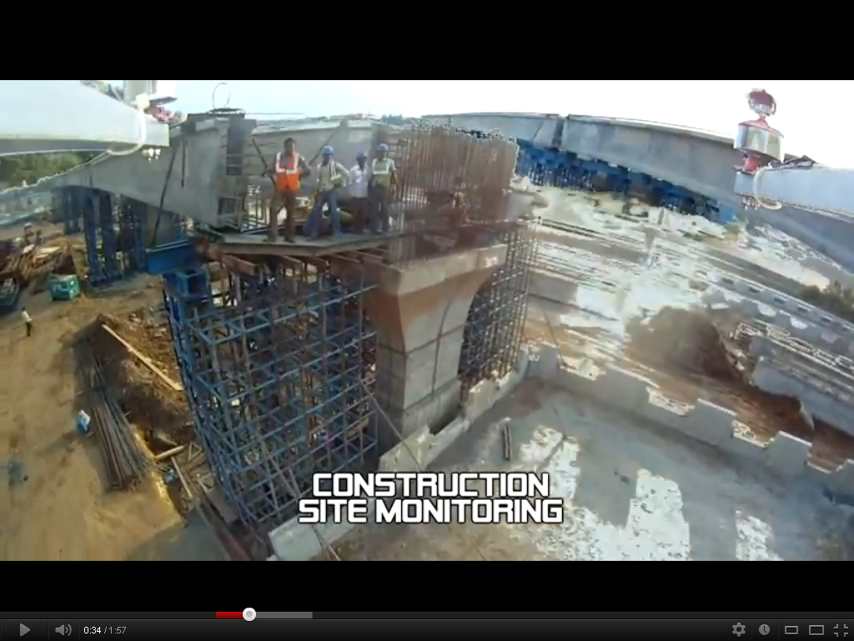

Slide 32
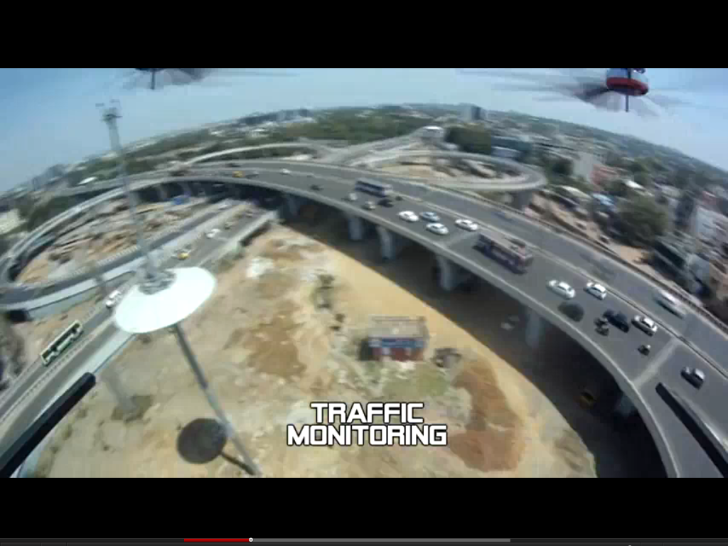

Slide 33
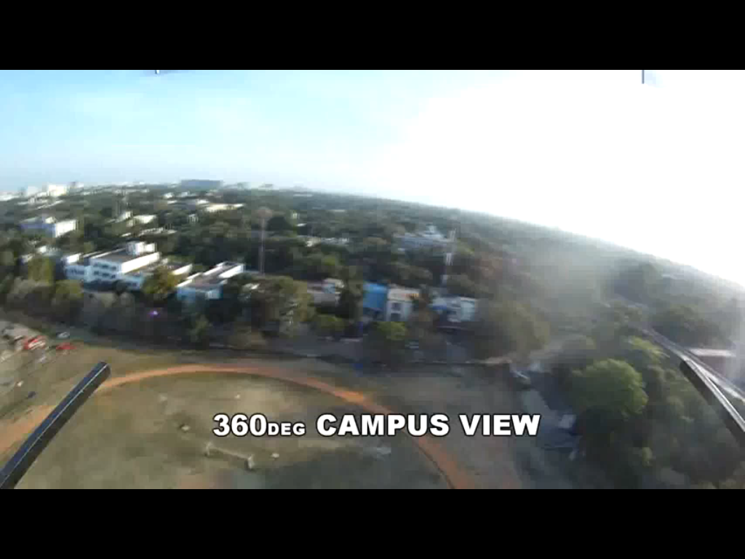

Slide 34
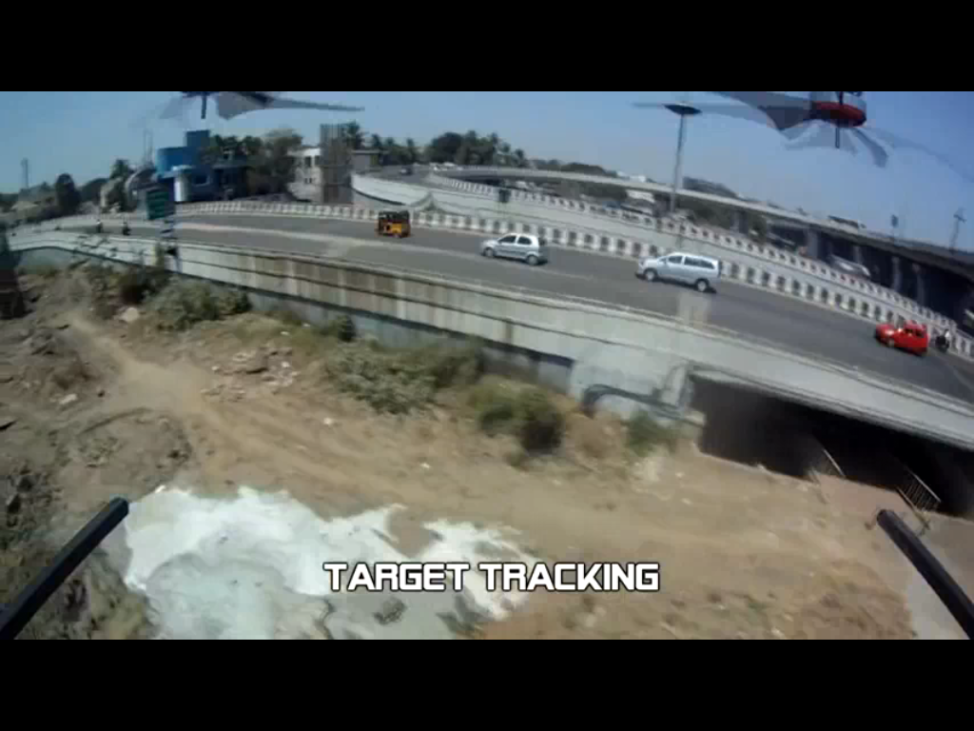

Slide 35
Our focus in DHAKSHA
Proposing cloud services for traffic monitoring
Police Bandobast
Agriculture applications

Slide 36
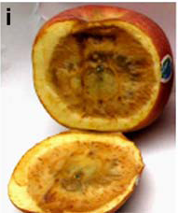
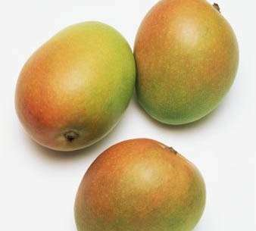
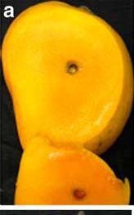
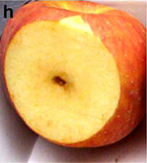
Agricultural Application
Agriculture and IT fields are merged
Defect detection in Mango Fruits
Alphonso Famous in Konkan from Maharastra
Agricultural university in Konkan, Maharashtra and CEERI had worked in spongy tissue problem

Slide 37
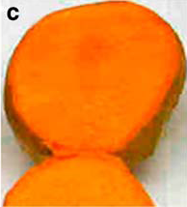
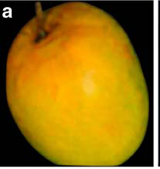
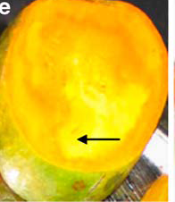

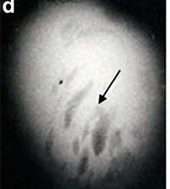
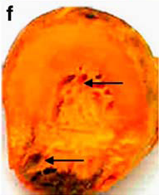
X Ray-Non spongy fruit
Non spongy fruit
Whole spongy fruit
Alphonso - spongy fruit
X Ray- spongy fruit
spongy fruit with air cavity

Slide 38
Application – A Trial @CEERI (Centre for Electrical and Electronics Research Institute)
Detection of defects in Fruits
Application is already available as a sequential one
MPI code has been developed and tested in our test bed.
Increase in throughput has been achieved by creating virtual machines and executing the code in parallel .
38
Notes:
38

Slide 39
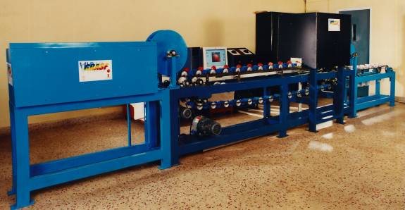
CEERI Lab
39
Notes:
39
39

Slide 40
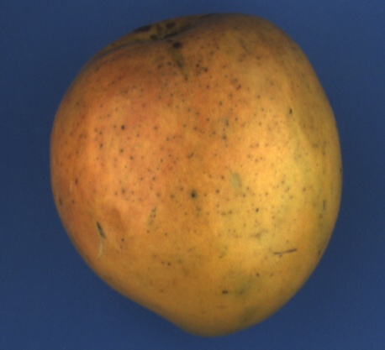
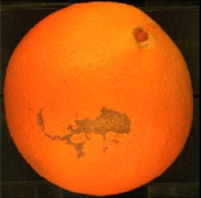
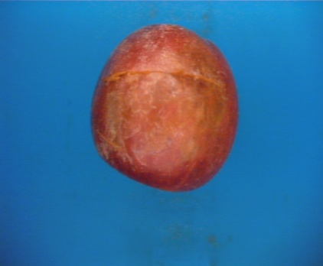
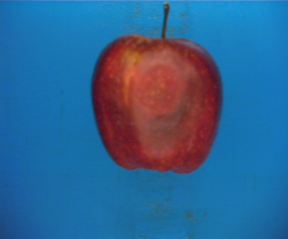
Surface Defects
Peel Defects
Line Defects
Mechanical Defects
40
Notes:
40
40

Slide 41
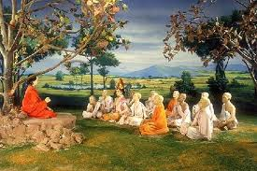
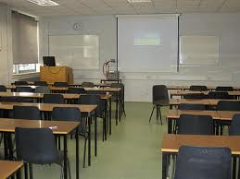

Educational World is changing
On site Teaching /Learning
Gurukulum
Class room
On line Teaching / Learning
Distance Education
On line courses
Short term Training
Certificate Courses

Slide 42

Gurukulum teaching(Guru-Sishyan)
Learner has to follow the instructions of Guru
Guru is the authority of evaluation
No standard syllabi or curriculum or evaluation
Guru centered
Knowledge oriented

Slide 43
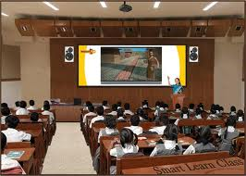
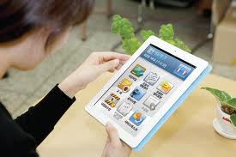
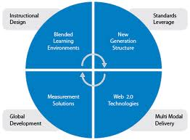
Smart Learning

Slide 44
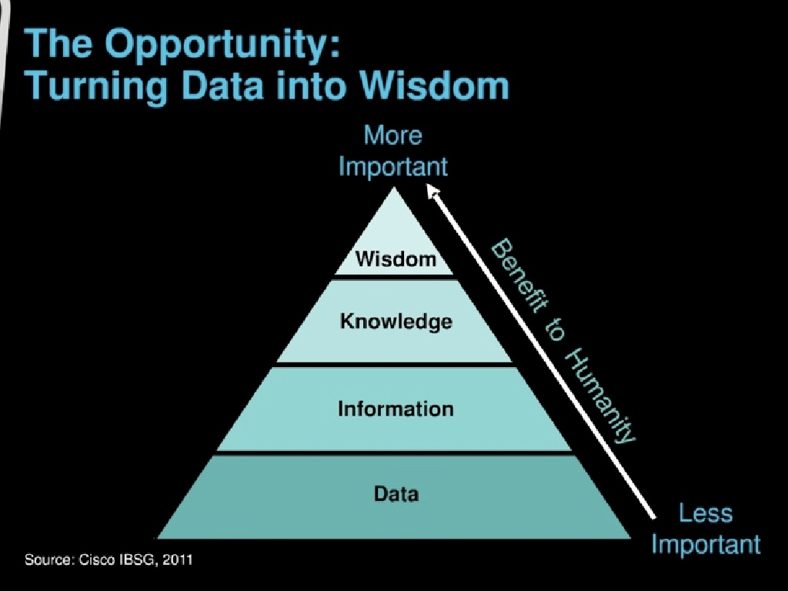

Slide 46
Our Current research Focus
E learning, M learning and U learning
Gurukula Teaching was our ancient method of teaching
We follow that conceptual idea for our current teaching / learning process

Slide 47
Our Current research Focus
E learning, M learning and U learning
Gurukula Teaching was our ancient method of teaching
We follow that conceptual idea for our current teaching / learning process

Slide 48
Athabasca University- Canada
Open University in Canada
We are working with Athabasca University to perform Learner Analytics
Proof of concept is over

Slide 49
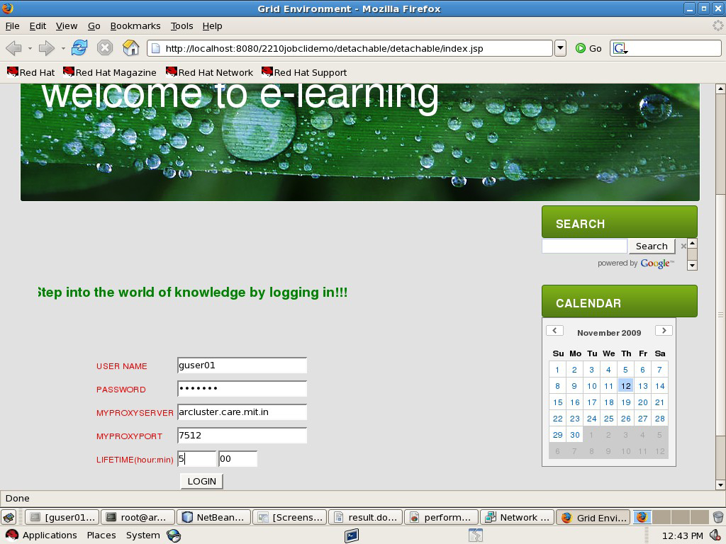
RESULT:
The user enters into the e-learning system by logging in.

Slide 50
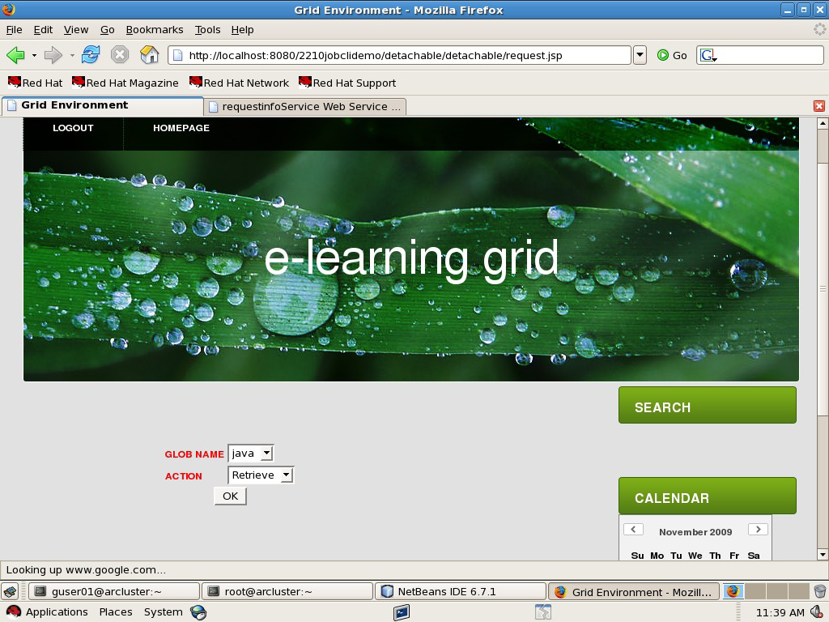
The e-learning user submits a GLOB request.

Slide 51
Development of U-Learning Framework
We develop an U-Learning Framework in collaboration with Athabasca University
We developed the metadata based on SCORM standard (Shareable Content Object Reference Model).
Framework uses multitenant approach and It is based on metadata driven architecture

Slide 52
U-Learning Framework
We make use of Moodle, Eclipse, VPL, JESS tutors and Hackystat sensor for the implementation
We make use of HDFS for storing big data of learners data
We use Learning traces for Teaching /Learning

Slide 53
Trace
Trace – History of user actions collected in real time from his/her interactions with the computer environment
Action may be
Opening a file
Clicking a hyperlink
Coding and compiling
Posting a message in forum, etc

Slide 54
Formalization - Trace
Trace T= <u,task, (O₁,O₂,…,O_{n})>
u-user
task-description of user task
O_{i}-observed element, (A_{i},M_{i})
A_{i} : action, with a defined structure
M_{i} : modality; M_{i}=<d,L>, d-interaction device, L-interaction language

Slide 55
Model Tracing
Intelligent Tutoring Systems that track learner progress at each step of a problem-solving process are called Model Tracing Tutors
E.g., www.algebratutor.org
Each step is algebraic problem solving is tracked and mapped onto a model
Feedback can be offered when learners veer away from correct pathways

Slide 56
Model Trace
Set of instructions is predefined for each part of the course
The learner is monitored for the individual step as per the given instruction and is corrected for the mistakes committed
It is the atomic level of monitoring each instruction in the learning process

Slide 57
Knowledge Tracing
Model students' changing knowledge state during skill acquisition.
An ideal student model is defined in terms of production rules.
As the student works, the tutor also maintains an estimate of the probability that the student has learned each of the rules in the ideal model, in a process called knowledge tracing.
E.g., ACT Programming Tutor (APT)
ACT - Adaptive Character of Thought
ACT -R Adaptive Character of Thought - Rational
APT is a problem solving environment in which students learn to write short programs in Lisp, Pascal or Prolog.

Slide 58
Learning Traces
We define learning trace as observable information about the learner, the type of learning, what had been learned, how effectively it had been learned, evidence of learning, and learning resources.
Learning trace tutors do not pre-define models of competencies or skills as in model-tracing and knowledge-tracing tutors. Instead, they generate competency models dynamically from observed learner interactions.
Notes:
Types of Learning: http://www.nwlink.com/~donclark/hrd/bloom.html, www.oecd.org/dataoecd/42/13/34926352.pdf, http://home.epix.net/~tcannon1/Physioweek10.htm
Learning Trace: example: A pointed object penetrates better than a blunt object. Why? a visual-oriented learner may choose to see this in action and may attempt to explain the results; a psychomotor-oriented learner may take a sharp pencil and test it against his palm and may attempt to explain the results; a cognition-oriented student may workout the mathematics behind pressure and may attempt to explain the results. In this case, the learner is tackling the concept of pressure. We can gather information about the learner’s background skills, the types of learning attempted by this learner, the extent to which the learner learned the concept, did it take a reasonable amount of time (effectiveness), did the assessments conclude that the concept had been learned, evidences of learning activities/experiences (e.g., a video of the learner trying a sharp pencil on someone’s palm and the learner’s answer to the question on pressure in the examination), and resources used by learner (e.g., the pencil, simulation run by the learner, …).

Slide 59
Learning Traces
Example: Online activities of a novice programmer in the context of an assignment can be traced in terms of
the UML design of the solution
coding efforts of the solution in a programming language
debugging efforts
testing efforts
documenting efforts
code optimisation efforts
Thus, learning traces capture information about the entire learning process and pathways (correct or otherwise) the learner has taken so far.

Slide 60
Learning Traces Example – letter writing for 7th grade learners
Learner A | Learner B
Sessions/sentences modified or created: 68 14 188 74 2 289 87 45 41 22 | Sessions/sentences modified or created: 454 12
Number of grammar mistakes corrected immediately, while writing the letter vs. corrected later : 23 vs. 112 | Number of grammar mistakes corrected immediately, while writing the letter: 68 vs. 20
Number of times sentences or phrases were moved around: 145 | Number of times sentences or phrases were moved around: 69
Number of spelling mistakes :-corrected immediately vs. yet to be corrected: 78 vs. 5 | Number of spelling mistakes :-corrected immediately vs. yet to be corrected: 33 vs. 8
Marks scored : 85% | Marks scored: 70%

Slide 61
Learning Traces
These raw data can be mapped onto skeletal structures corresponding to various educational theories or instructional models
This mapping can happen dynamically, as and when learners study
This mapping can be causal in nature

Slide 62
Advantages of Learning Traces
Dynamic model of traces enable learners to cover most of the possible mistakes and errors in learning
Repeated exercise on tracing different sets of learners helps in refining the model each time and may stabilize over a period of time
The models evolved across institutions may reflect the customs and culture of learners.
Standard models are to be pruned out of potential models.

Slide 63
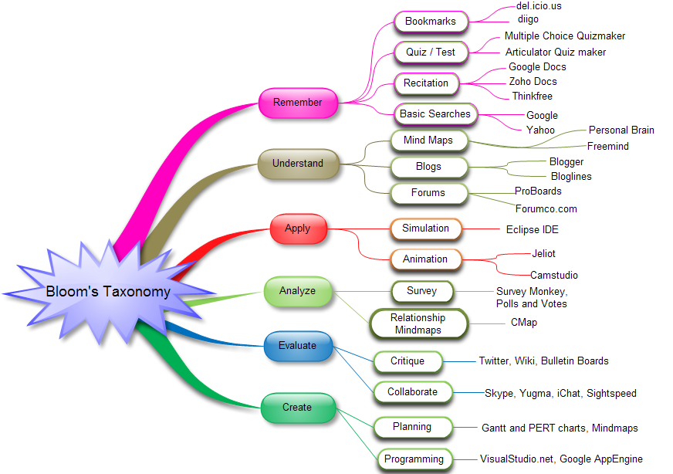
Remember

Slide 64
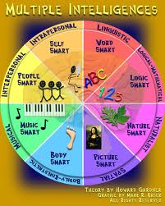
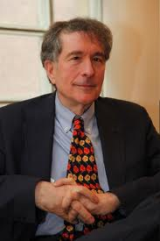
Dr.Howard Gardner
Source: www.ThomasArmstrong.com

Slide 65
Applications
It is possible to compare the quality of education across the Institutions.
Quality of education may be standardized based on the competency achieved
Accreditation may be based on the models conceived by Learning Traces

Slide 66
Authoring Books
S. Thamarai Selvi, R. Murugesan, “Text Book on C#”, Pearson Education 2003.
Rajkumar Buyya, S. Thamarai Selvi, Xingchen Chu, "Object Oriented Programming with Java Essentials and Applications", Tata McGraw Hill, New Delhi, 2009.
S. Thamarai Selvi, R. Murugesan, “Test Your Skills in C”, Tata McGraw Hill, New Delhi, 2009. 2009 (Revised).
S. Thamarai Selvi, R. Murugesan, “C for All”, Anuradha Publishers 2010 (Revised).
Rajkumar Buyya, Christian, S. Thamarai Selvi, “Mastering Cloud Computing” Morgan Kaufmann, USA, 2013.

Slide 67
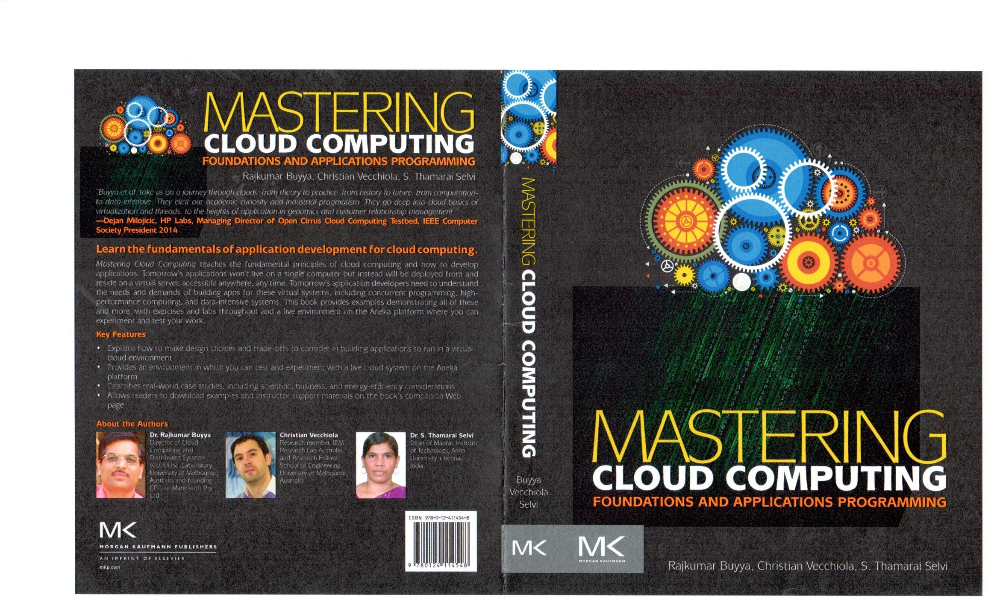

Slide 68
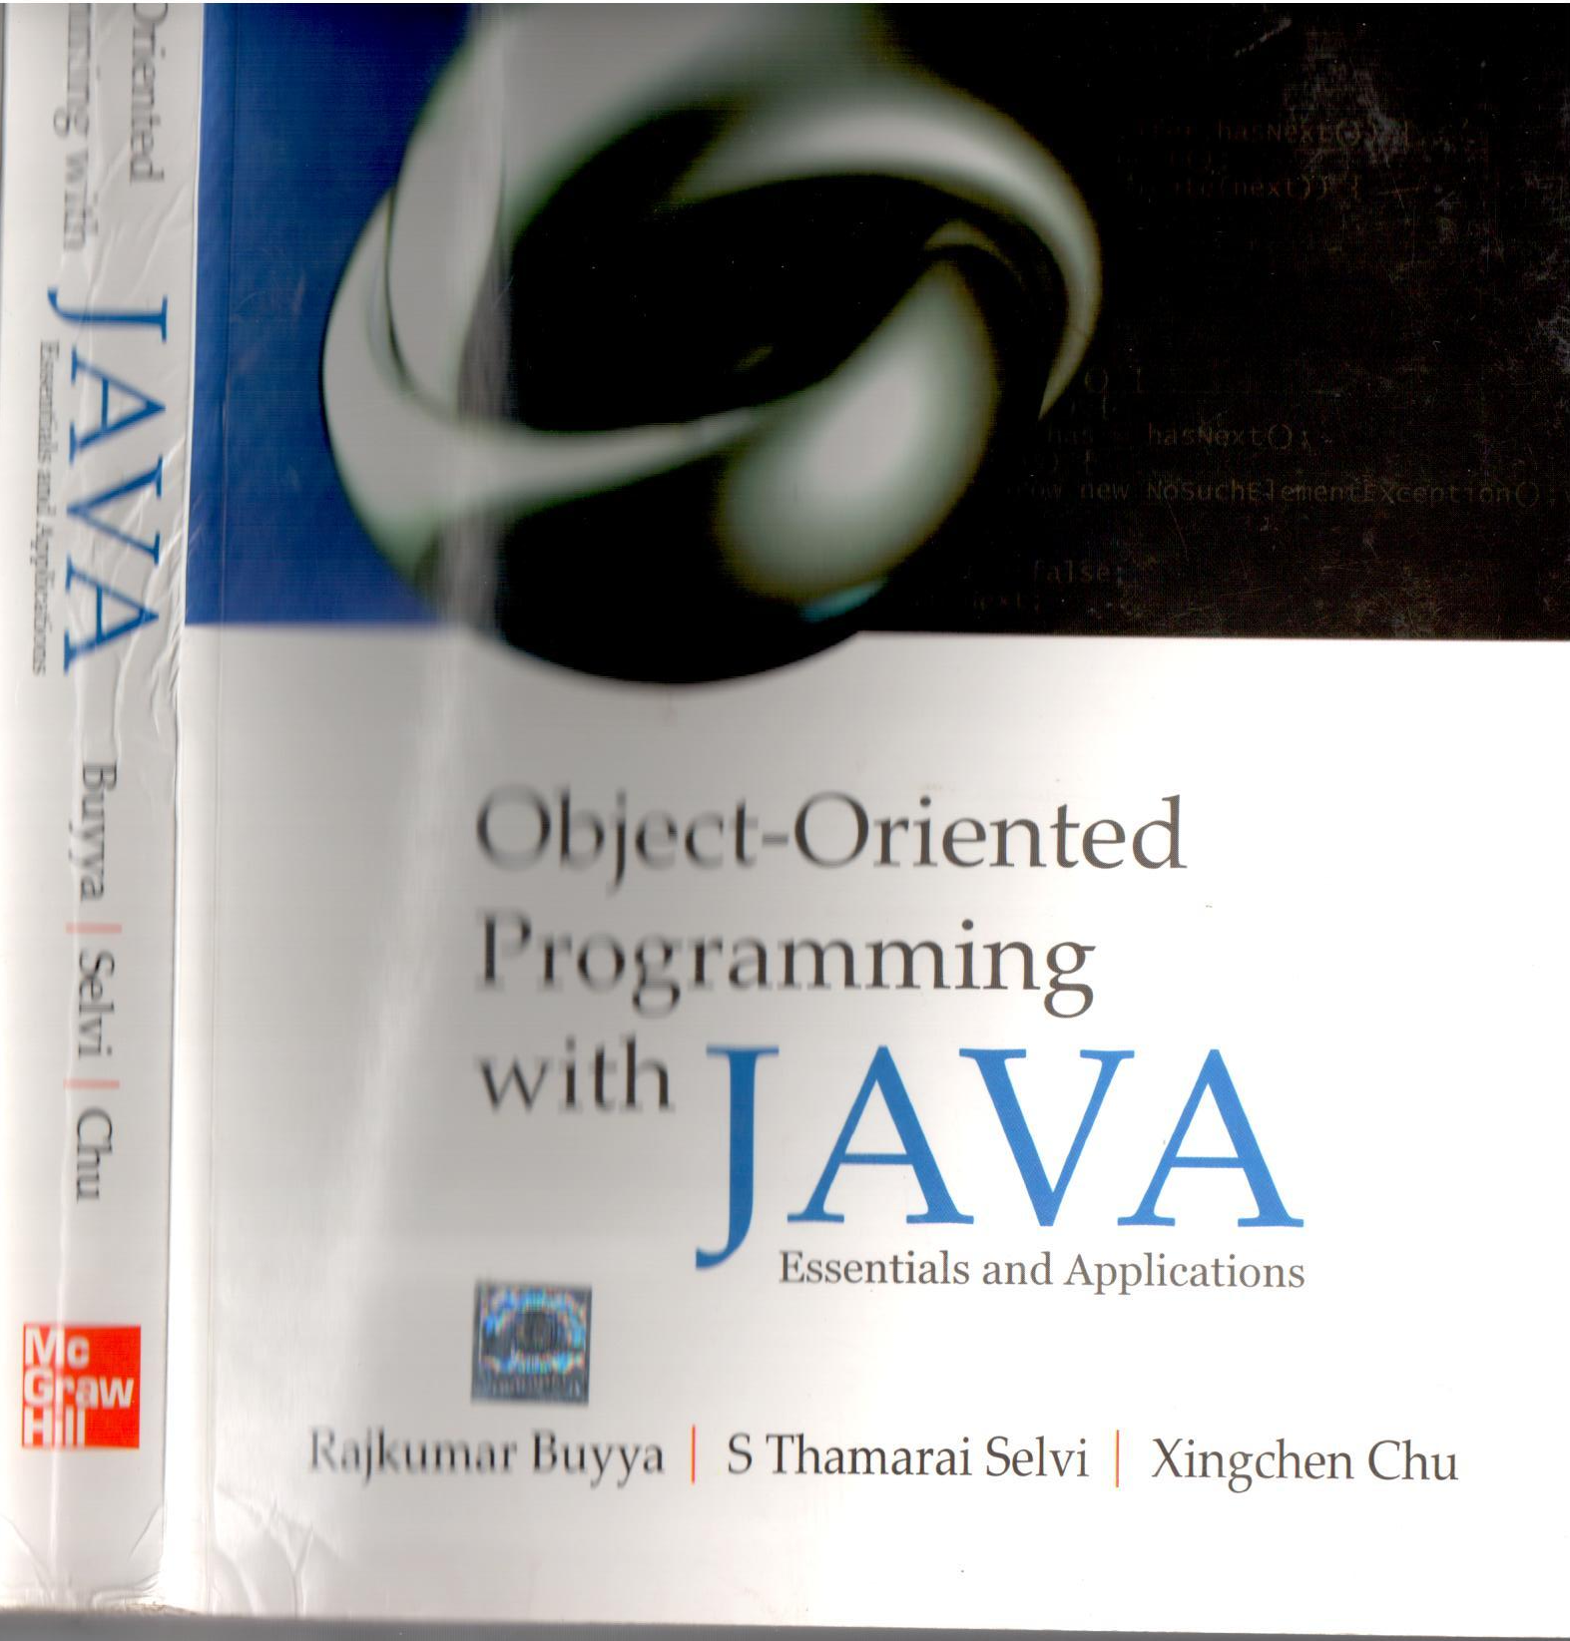

Slide 69
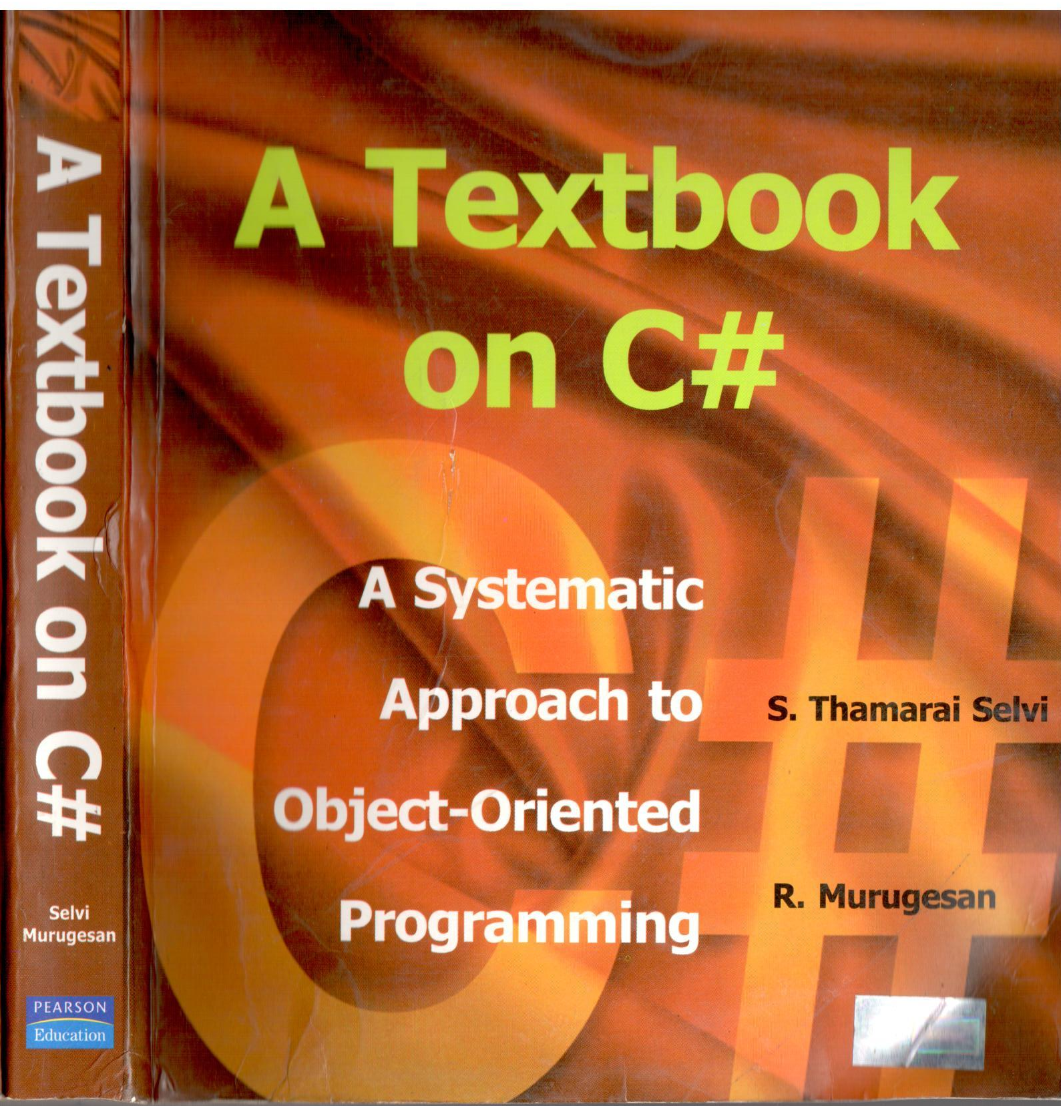

Slide 70
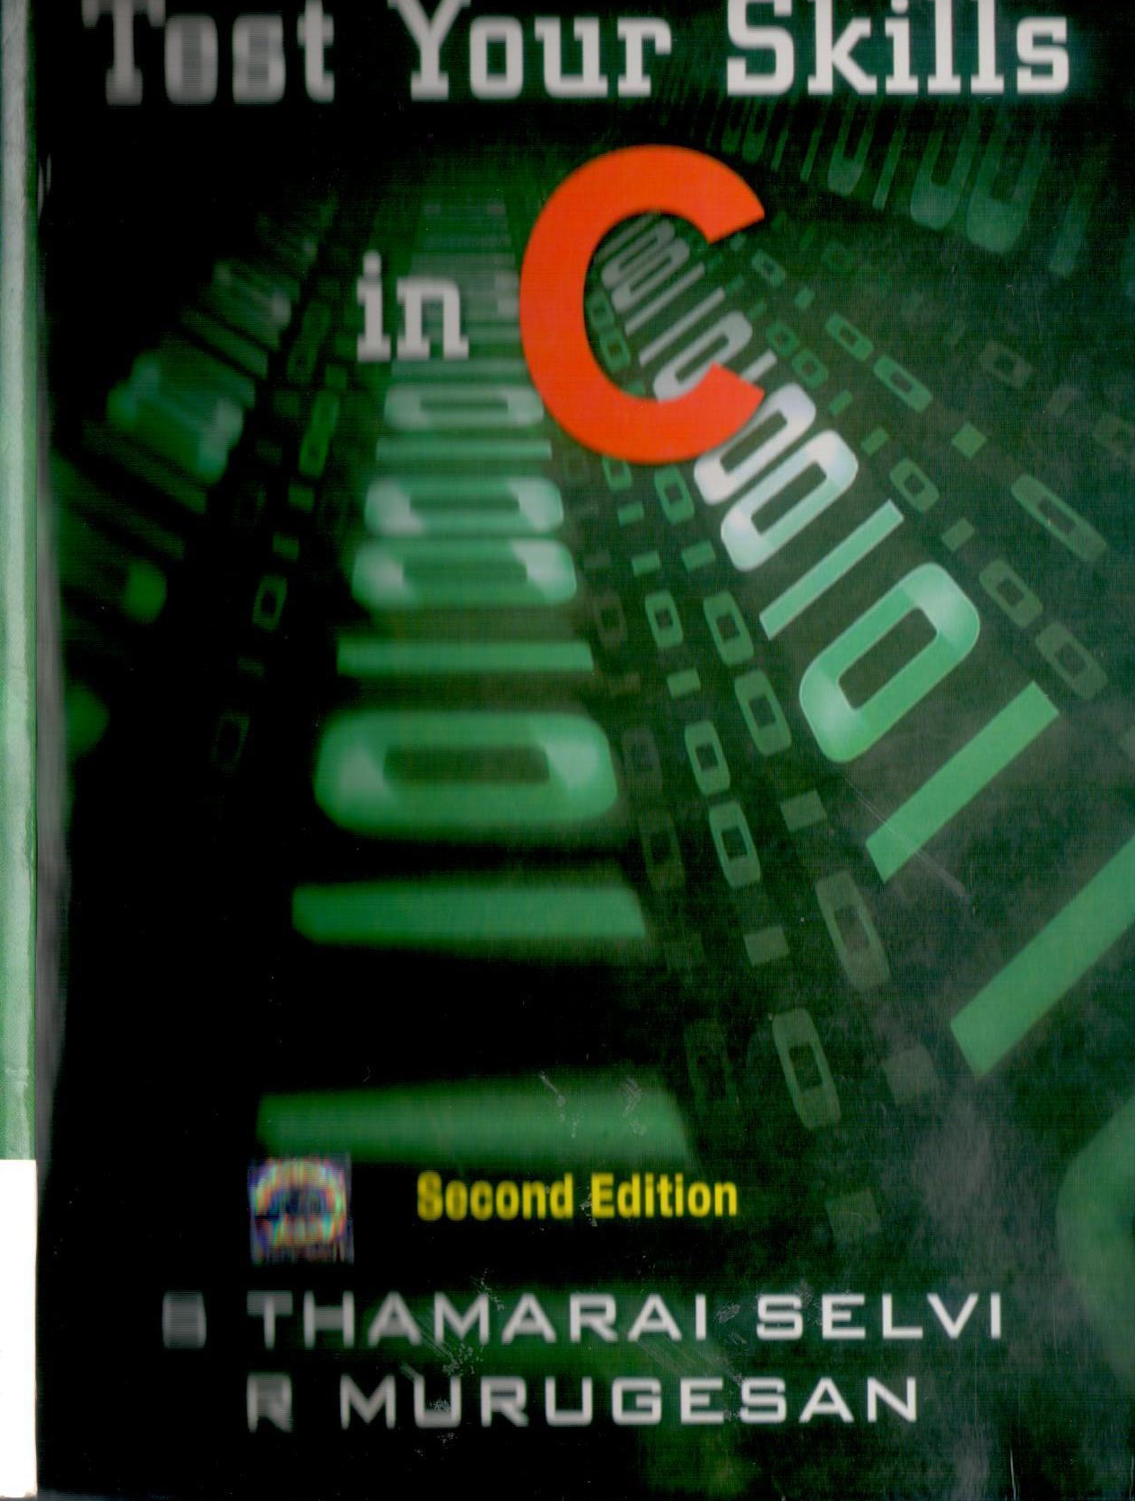

Slide 71
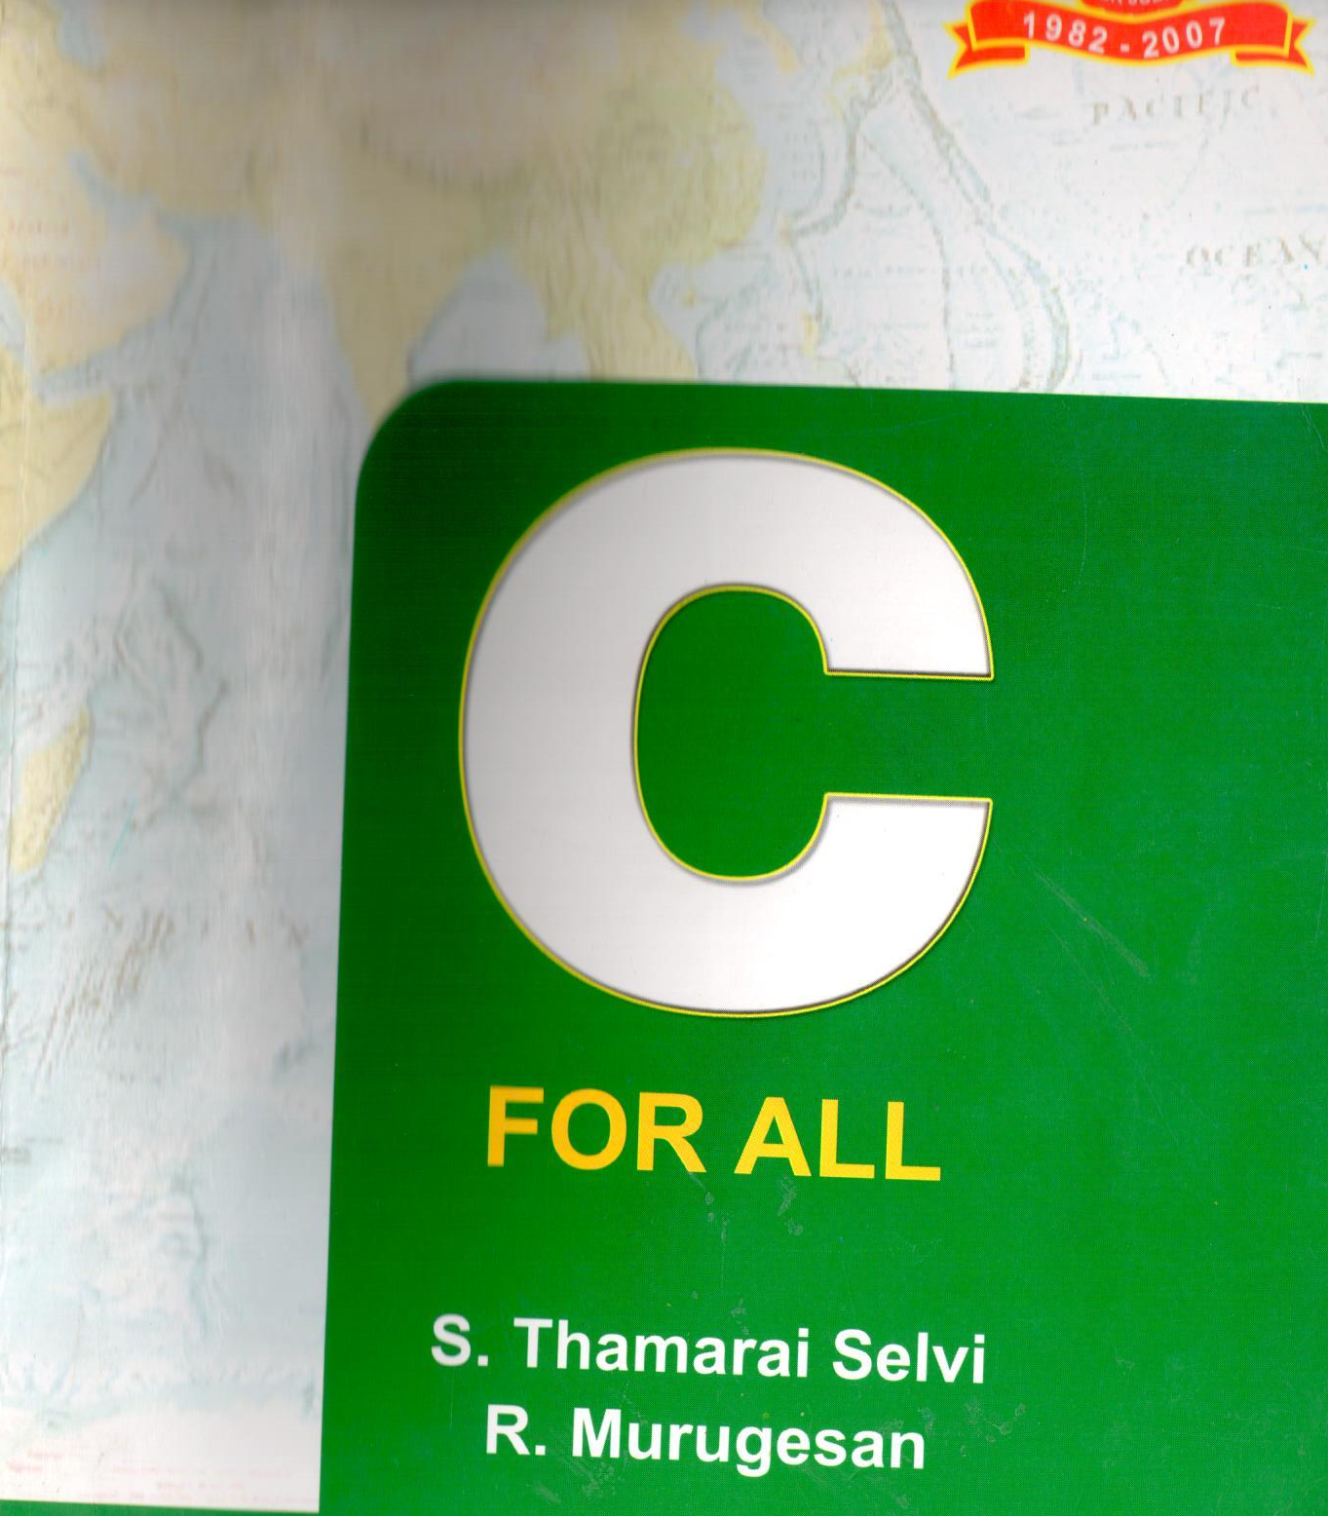

Slide 72
Our Research Collaborations
CDAC, Bangalore
Garuda Grid - Semantic Resource Discovery
CEERI, India
Surface/Inner Defect Identification of Fruits
Athabasca University, Canada
E-Learning
University of Madrid, Spain
Gridway and OpenNebula – Part of Scheduling
MIMOS, Malaysia
Virtualizing Computing Element
Honeywell, Bangalore, India
Intelligent creation of Virtual Machines

Slide 73
Conclusion
Our research focus had been discussed
We are interested in having collaborative research with PRAGAMA in Cloud applications

Slide 74

Suggestions and Clarifications

Slide 75
Thank You for your attention

